Slide 1
Use Case Modeling
Chapter 5
Systems Analysis and Design in a Changing World 7th Ed
Satzinger, Jackson & Burd

Slide 2
Chapter 5 Outline
Use Case Descriptions
Activity Diagrams for Use Cases
The System Sequence Diagram—Identifying Inputs and Outputs
SSD Notation
Use Cases and CRUD
Integrating Requirements Models

Slide 3
Learning Objectives
Write fully developed use case descriptions
Develop activity diagrams to model flow of activities
Develop system sequence diagrams
Use the CRUD technique to validate use cases
Explain how use case descriptions and UML diagrams work together to define functional requirements

Slide 4
Overview
Chapters 3 and 4 identified and modeled the two primary aspects of functional requirements: use cases and domain classes
This chapter focuses on detail modelling for use cases to document the internal steps within a use case
Fully developed use case descriptions provide information about each use case, including actors, stakeholders, preconditions, post conditions, the flow of activities and exceptions conditions
Activity diagrams (first shown in Chapter 2) can also be used to show the flow of activities for a use case

Slide 5
Overview (continued)
System sequence diagrams (SSDs) show the inputs and outputs for each use case as messages
CRUD analysis (create, read, update and delete), which correlates problem domain classes and use cases, is an effective technique to double check that all required use cases have been identified
Not all use cases are modelled at this level of detail. Only model when there is complexity and a need to communicate details

Slide 6
Use Case Descriptions
Write a brief description as shown in Chapter 3 for most use cases.

Slide 7
Use Case Descriptions
Write a fully developed use case description for more complex use cases
Typical use case description templates include:
Use case name
Scenario (if needed)
Triggering event
Brief description
Actors
Related use cases (<<includes>>)
Stakeholders
Preconditions
Postconditions
Flow of activities
Exception conditions

Slide 8
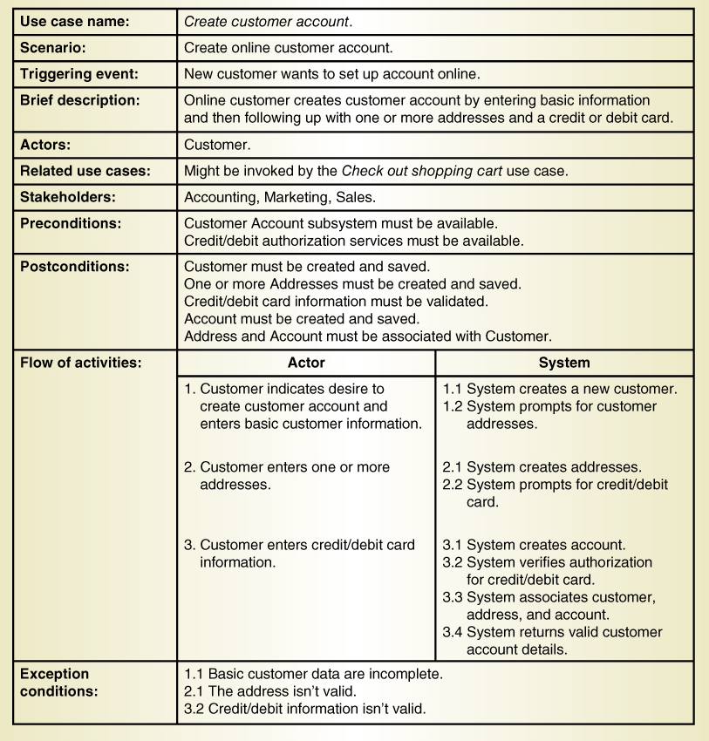
Fully Developed Use Case Description Use case: Create customer account

Slide 9
Use Case Description Details
Use case name
Verb-noun
Scenario (if needed)
A use case can have more than one scenario (special case or more specific path)
Triggering event
Based on event decomposition technique
Brief description
Written previously when use case was identified
Actors
One or more users from use case diagrams

Slide 10
Use Case Description Details
Related use cases <<includes>>
If one use case invokes or includes another
Stakeholders
Anyone with an interest in the use case
Preconditions
What must be true before the use case begins
Post conditions
What must be true when the use case is completed
Use for planning test case expected results
Flow of activities
The activities that go on between actor and the system
Exception conditions
Where and what can go wrong

Slide 11
Fully Developed Use Case Description Create customer account (part 1 )

Slide 12
Fully Developed Use Case Description Create customer account (part 2 )

Slide 13
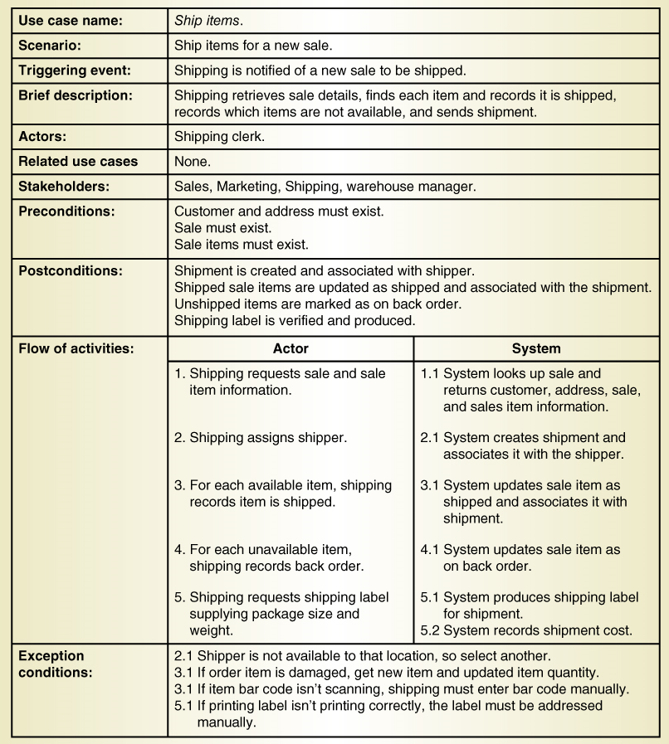
Another Fully Developed Use Case Description Example Use case Ship items

Slide 14
Fully Developed Use Case Description Ship items (part 1 )

Slide 15
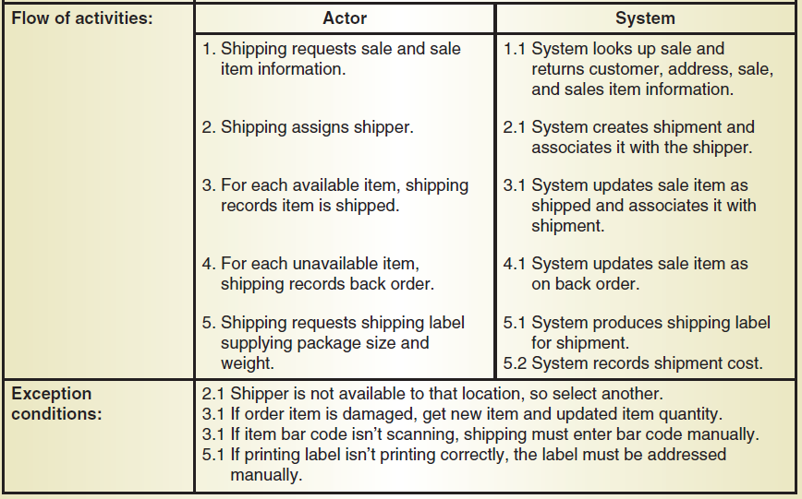
Fully Developed Use Case Description Ship items (part 2 )

Slide 16
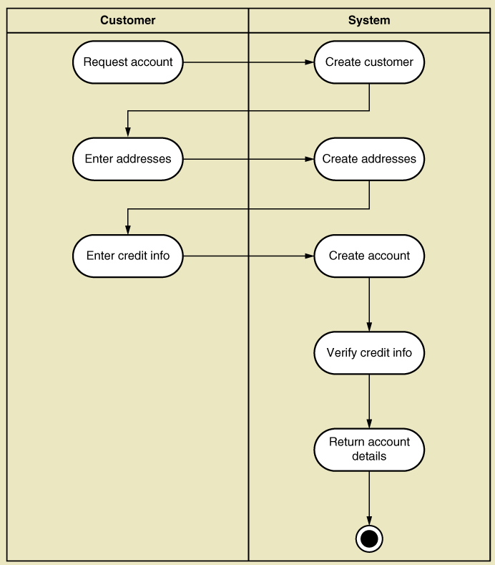
UML Activity Diagram for Use Case (Show the flow of activities for a use case) Example: Create Customer Account
Note: this shows flow of activities only

Slide 17
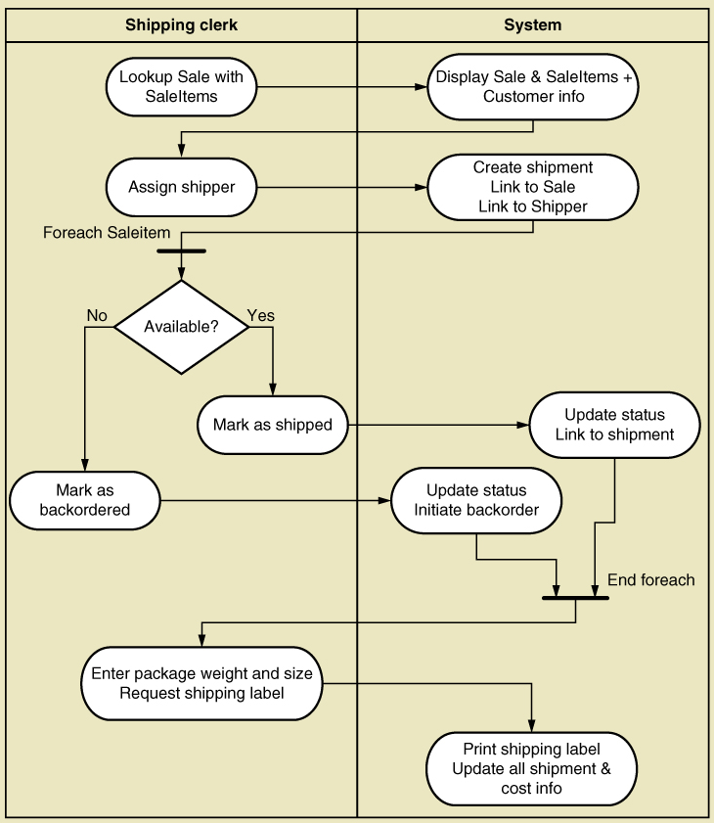
Activity Diagram for Ship Items Use Case
Note:
Synchronization bar for loop
Decision diamond

Slide 18
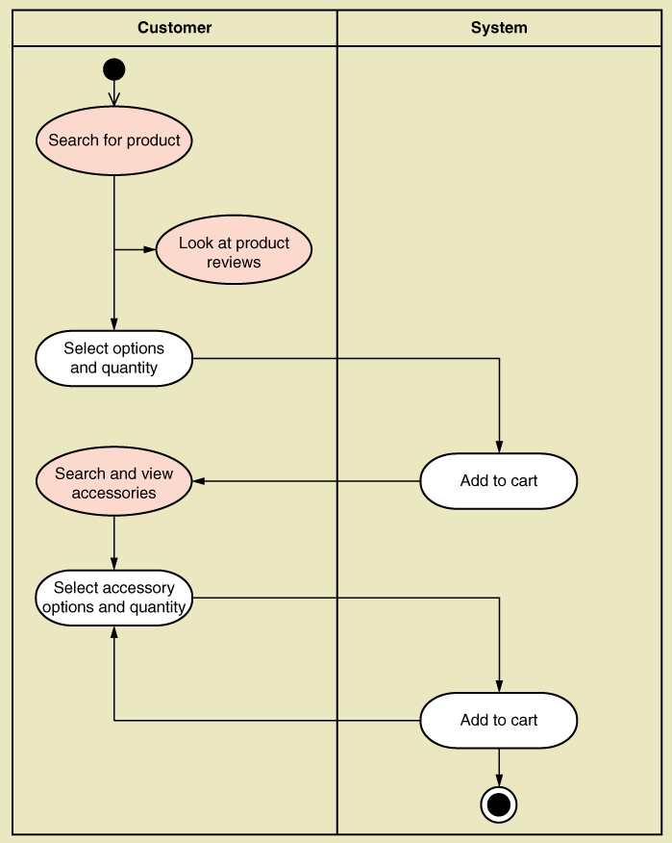
UML Activity Diagram for Use Case Fill shopping cart
Note: this shows use case with <<includes>> relationship

Slide 19
System Sequence Diagram (SSD)
A UML sequence diagram
Special case for a sequence diagram
Only shows actor and one object
The one object represents the complete system
Shows input & output messaging requirements for a use case
Actor, :System, object lifeline
Messages

Slide 20
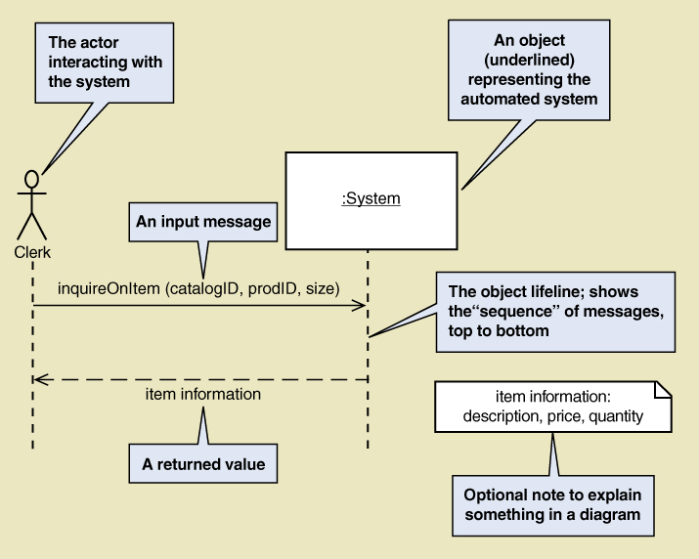
System Sequence Diagram (SSD) Notation

Slide 21
Steps for Developing SSD
Identify input message
See use case flow of activities or activity diagram
Describe the message from the external actor to the system using the message notation
Name it verb-noun: what the system is asked to do
Consider parameters the system will need
Identify any special conditions on input messages
Iteration/loop frame
Opt or Alt frame
Identify and add output return values
On message itself: aValue:= getValue(valueID)
As explicit return on separate dashed line

Slide 22
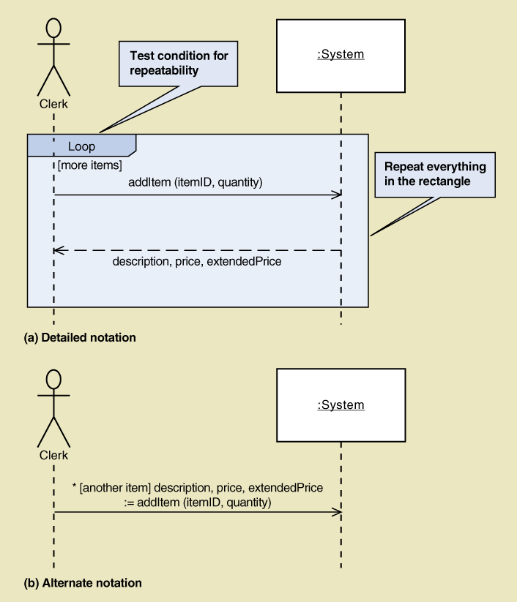
SSD Message Examples with Loop Frame
[true/false condition] return-value := message-name (parameter-list)

Slide 23
Message Notation for SSD
[true/false condition] return-value := message-name (parameter-list)
An asterisk (*) indicates repeating or looping of the message
Brackets [ ] indicate a true/false condition. This is a test for that message only. If it evaluates to true, the message is sent. If it evaluates to false, the message isn’t sent.
Message-name is the description of the requested service written as a verb-noun.
Parameter-list (with parentheses on initiating messages and without parentheses on return messages) shows the data that are passed with the message.
Return-value on the same line as the message (requires :=) is used to describe data being returned from the destination object to the source object in response to the message.

Slide 24
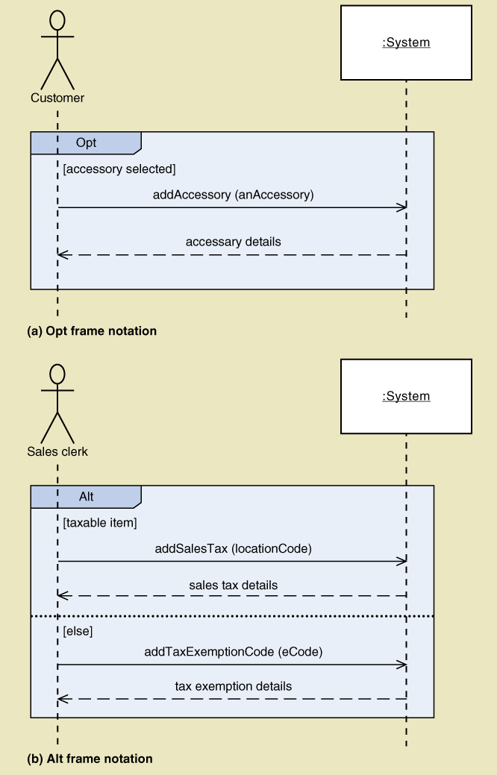
SSD Message Examples
Opt Frame (optional)
Alt Frame (if-else)

Slide 25
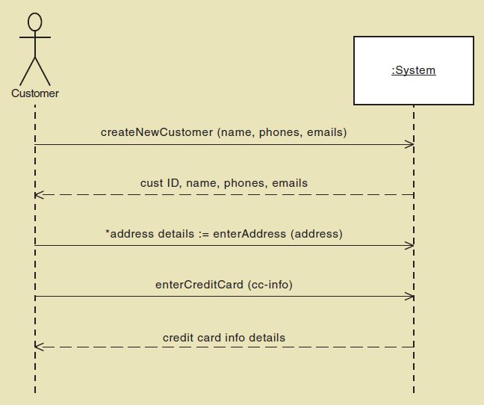
SSD for Create customer account Use case

Slide 26
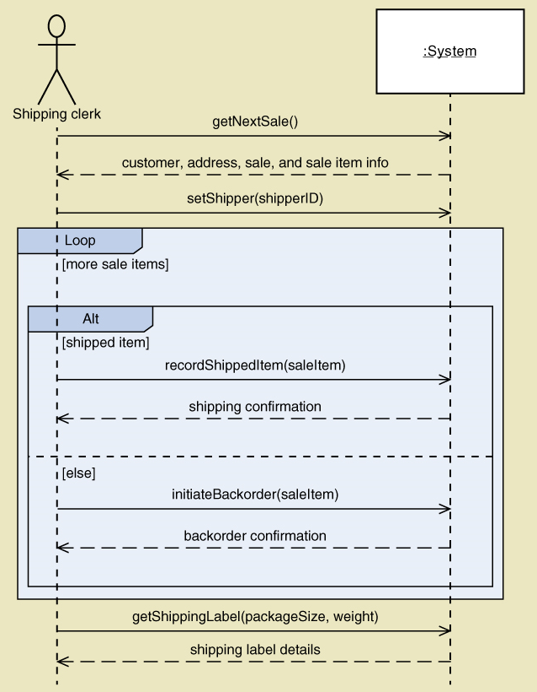
SSD for Ship items Use Case

Slide 27
Use Cases and CRUD
CRUD technique –
Create
Read/Report
Update
Delete
A good cross-check against the existing set of use cases. Used in database context
Ensure that all classes have a complete “cover” of use cases
Not for primary identification of use cases

Slide 28
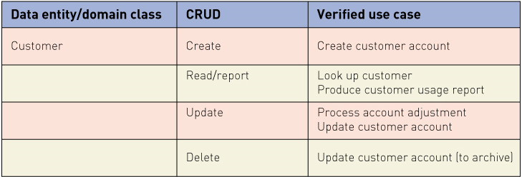
Verifying use cases for Customer

Slide 29
CRUD Analysis Steps
Identify all domain classes
For each class verify that use cases exist to
Create a new instance
Update existing instances
Reads or reports on information in the class
Deletes or archives inactive instances
Add new use cases as required. Identify responsible stakeholders
Identify which application has responsibility for each action: which to create, which to update, which to use

Slide 30
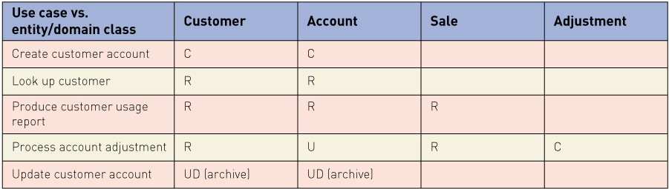
Sample CRUD Matrix

Slide 31
Extending and Integrating Requirements Models
Use cases
Use case diagram
Use case description
Activity diagram
System sequence diagram (SSD)
Domain Classes
Domain model class diagram
State machine diagram

Slide 32
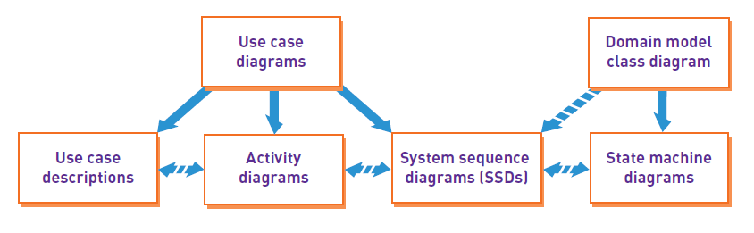
Integrating Requirements Models

Slide 33
Summary
Chapters 3 and 4 identified and modeled the two primary aspects of functional requirements: use cases and domain classes
This chapter focuses on models to provide details of use cases
Fully developed use case descriptions provide information about each use case, including actors, stakeholders, preconditions, post conditions, the flow of activities and exceptions conditions
Activity diagrams (first shown in Chapter 2) can also be used to show the flow of activities for a use case

Slide 34
Summary (continued)
System sequence diagrams (SSDs) show the inputs and outputs for each use case as messages
CRUD analysis serves to verify that all domain classes are fully supported by the new system, i.e. have use cases to fully process all required actions
Not all use cases and domain classes are modelled at a detailed level. Only model when there is complexity and a need to communicate details.
All of the models must be consistent and integrate together to provide a complete picture of the requirements and specification.

